Slide 1

Wednesday 25 September 2024
Simple and Compound Interest
Interest [Maths] : Money paid for the use of other money.
Typical questions:
Alice puts £3000 into an bank account.
The account pays 3% simple interest each year.
Work out how much interest Alice will get after 6 years.
Alice puts £3000 into an bank account.
The account pays 3% compound interest each year.
Work out how much interest Alice will get after 6 years.

Slide 2

Simple Interest
Example | Your Turn
Adam puts £1725 into an bank account. The account pays 2.25 % simple interest each year. Work out how much interest Adam will get after 6 years. | Alice invests £3955 into an savings account. Alice gets 1.5% per year simple interest. Work out the total interest Alice will get after 12 years.
Notes:
This is an example problem pair. The best place to start out with these is Craig Barton’s book ‘How I Wish I Taught Maths’. The basic idea is this : they copy down the slide. You do the example, writing on the powerpoint and they copy it down. You then reveal the ‘your turn’ question. They then have a go and you can check they can apply the procedure correctly. It’s a really nice way of teaching, I’ve found. I have left the explanation completely up to you, as I wanted to get away from clicking through explanations, which I’m not a fan of.

Slide 3
Simple interest
Fill in the blanks. All amounts are in USD.
Initial amount | Interest Rate | Amount earned per year | Interest earned over 5 years | Total after 5 years
100 | 10% | 10 | 50 | 150
100 | 1% | 1 | 5 | 105
100 | 2% | 2 | 10 | 110
100 | 4% | 4 | 20 | 120
200 | 4% | 8 | 40 | 240
600 | 4% | 24 | 120 | 720
600 | 100% | 600 | 3000 | 3600
500 | 0.5% | 2.5 | 12.5 | 512.5
250 | 0.5% | 1.25 | 6.25 | 256.25

Slide 4
Compound interest
Example | Your Turn
Adam puts £1725 into an bank account. The account pays 2.25 % compound interest each year. Work out how much interest Adam will get after 6 years. | Alice invests £3955 into an savings account. Alice gets 1.5% per year compound interest. Work out the total interest Alice will get after 12 years.
Notes:
This is an example problem pair. The best place to start out with these is Craig Barton’s book ‘How I Wish I Taught Maths’. The basic idea is this : they copy down the slide. You do the example, writing on the powerpoint and they copy it down. You then reveal the ‘your turn’ question. They then have a go and you can check they can apply the procedure correctly. It’s a really nice way of teaching, I’ve found. I have left the explanation completely up to you, as I wanted to get away from clicking through explanations, which I’m not a fan of.

Slide 5
Compound interest
Fill in the blanks. All amounts are in USD.
Initial amount | Interest Rate | Amount earned in year 1 | Interest earned over 5 years | Total after 5 years
100 | 10% | 10 | 61.05 | 161.05
100 | 1% | 1 | 5.01 | 105.01
100 | 2% | 2 | 10.41 | 110.41
100 | 4% | 4 | 21.67 | 121.67
200 | 4% | 8 | 43.33 | 243.33
600 | 4% | 24 | 129.99 | 729.99
600 | 100% | 600 | 18600 | 19200
500 | 5% | 25 | 138.14 | 638.14
500 | 0.5% | 2.5 | 12.63 | 512.63

Slide 6
Compound interest
$5000 is invested.
Two options are available:
5% simple interest.
1% compound interest.
Which is the better option?
Link to visualisation

Slide 7
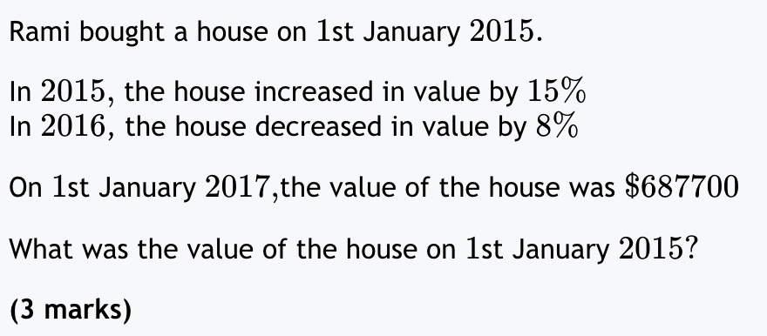
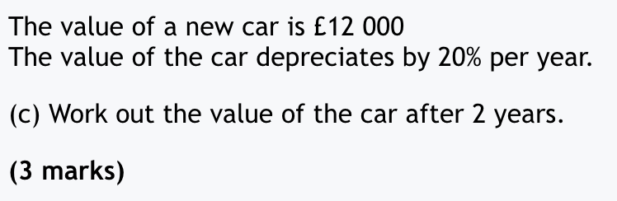
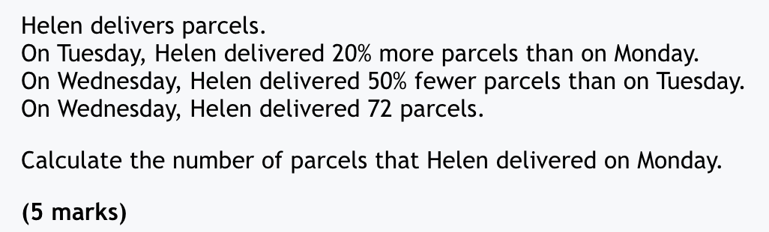
Compound interest

Slide 8
Compound interest
Andrew invests some money.
The interest rate he receives is the same every year.
After ten years of investment, he has twice as money as he started with.
What was the interest rate he received?
You may need to use some trial and improvement.

Slide 9
Compound interest
Blooket

Slide 10
Compound interest
Example | Your Turn
Adam buys a car. He pays $35,000. The car depreciates in value by 5% each year. How much is the car worth after 5 years? | Adam buys a laptop. He pays $1,200. The laptop depreciates in value by 10% each year. How much is the laptop worth after 3 years?
Notes:
This is an example problem pair. The best place to start out with these is Craig Barton’s book ‘How I Wish I Taught Maths’. The basic idea is this : they copy down the slide. You do the example, writing on the powerpoint and they copy it down. You then reveal the ‘your turn’ question. They then have a go and you can check they can apply the procedure correctly. It’s a really nice way of teaching, I’ve found. I have left the explanation completely up to you, as I wanted to get away from clicking through explanations, which I’m not a fan of.

Slide 11
Compound interest
Write the question letter underneath it’s answer to spell a capital city.
V) Mark buys a car. It costs $75,000. It depreciates in value by 5% every year. How much is it worth after 20 years?
S) Adam buys a collectable card. It costs $100. It appreciates in value by 55% every year. How much will it be worth in 30 years?
A) A company, Tones inc, buys 40 laptops. They cost $2,000 each. They depreciate in value by 10% each year. How much, in total, will they be worth in 4 years?
U) Scott buys a piece of bad art for $1,000,000. It’s so ugly that it depreciates in value by 85% a year. How much will it be worth in 2 years?
$71610.30
$22500
$26886.44
$52488
S
u
v
a

Slide 12
Simple and Compound Interest
5 QUICK QUESTIONS CHECK
Get ready…

Slide 13
Simple and Compound Interest
1
I borrow $500.
I pay 5% simple interest per annum.
How much interest do I pay over 3 years?

Slide 14
Simple and Compound Interest
2
I borrow $500.
I pay 5% compound interest per annum.
How much interest do I pay over 3 years?

Slide 15
Simple and Compound Interest
3
I borrow $500.
I pay 5% simple interest per annum.
How much interest do I pay over 20 years?

Slide 16
Simple and Compound Interest
4
I borrow $500.
I pay 5% compound interest per annum.
How much interest do I pay over 20 years?

Slide 17
Simple and Compound Interest
5
I pay $900 for a laptop.
It depreciates in value by 40% each year.
How much is it worth after 6 years?

Slide 18
Simple and Compound Interest
Your answers:
$75
$78.81
$500
$1276.65
$41.99

Slide 19
Simple Interest
Example | Your Turn
Adam puts £1725 into an bank account. The account pays 2.25 % simple interest each year. Work out how much interest Adam will get after 6 years. | Alice invests £3955 into an savings account. Alice gets 1.5% per year simple interest. Work out the total interest Alice will get after 12 years.
Notes:
This is an example problem pair. The best place to start out with these is Craig Barton’s book ‘How I Wish I Taught Maths’. The basic idea is this : they copy down the slide. You do the example, writing on the powerpoint and they copy it down. You then reveal the ‘your turn’ question. They then have a go and you can check they can apply the procedure correctly. It’s a really nice way of teaching, I’ve found. I have left the explanation completely up to you, as I wanted to get away from clicking through explanations, which I’m not a fan of.

Slide 20
Simple interest
Fill in the blanks. All amounts are in USD.
Initial amount | Interest Rate | Amount earned per year | Interest earned over 5 years | Total after 5 years
100 | 10% | 10 | 50 | 150
100 | 1% | 1 | 5 | 105
100 | 2% | 2 | 10 | 110
100 | 4% | 4 | 20 | 120
200 | 4% | 8 | 40 | 240
600 | 4% | 24 | 120 | 720
600 | 100% | 600 | 3000 | 3600
500 | 0.5% | 2.5 | 12.5 | 512.5
250 | 0.5% | 1.25 | 6.25 | 256.25

Slide 21
Compound interest
Example | Your Turn
Adam puts £1725 into an bank account. The account pays 2.25 % compound interest each year. Work out how much interest Adam will get after 6 years. | Alice invests £3955 into an savings account. Alice gets 1.5% per year compound interest. Work out the total interest Alice will get after 12 years.
Notes:
This is an example problem pair. The best place to start out with these is Craig Barton’s book ‘How I Wish I Taught Maths’. The basic idea is this : they copy down the slide. You do the example, writing on the powerpoint and they copy it down. You then reveal the ‘your turn’ question. They then have a go and you can check they can apply the procedure correctly. It’s a really nice way of teaching, I’ve found. I have left the explanation completely up to you, as I wanted to get away from clicking through explanations, which I’m not a fan of.

Slide 22
Compound interest
Fill in the blanks. All amounts are in USD.
Initial amount | Interest Rate | Amount earned in year 1 | Interest earned over 5 years | Total after 5 years
100 | 10% | 10 | 161.05 | 261.05
100 | 1% | 1 | 105.01 | 205.01
100 | 2% | 2 | 110.41 | 210.41
100 | 4% | 4 | 121.67 | 221.67
200 | 4% | 8 | 243.33 | 443.33
600 | 4% | 24 | 729.99 | 1329.99
600 | 100% | 600 | 19200 | 19800
500 | 5% | 25 | 638.14 | 1138.14
500 | 0.5% | 2.5 | 512.63 | 1023.63

Slide 23
Compound interest
Example | Your Turn
Adam buys a car. He pays $35,000. The car depreciates in value by 5% each year. How much is the car worth after 5 years? | Adam buys a laptop. He pays $1,200. The laptop depreciates in value by 10% each year. How much is the laptop worth after 3 years?
Notes:
This is an example problem pair. The best place to start out with these is Craig Barton’s book ‘How I Wish I Taught Maths’. The basic idea is this : they copy down the slide. You do the example, writing on the powerpoint and they copy it down. You then reveal the ‘your turn’ question. They then have a go and you can check they can apply the procedure correctly. It’s a really nice way of teaching, I’ve found. I have left the explanation completely up to you, as I wanted to get away from clicking through explanations, which I’m not a fan of.

Slide 24
Compound interest
Write the question letter underneath it’s answer to spell a capital city.
V) Mark buys a car. It costs $75,000. It depreciates in value by 5% every year. How much is it worth after 20 years?
S) Adam buys a collectable card. It costs $100. It appreciates in value by 55% every year. How much will it be worth in 30 years?
A) A company, Tones inc, buys 40 laptops. They cost $2,000 each. They depreciate in value by 10% each year. How much, in total, will they be worth in 4 years?
U) Scott buys a piece of bad art for $1,000,000. It’s so ugly that it depreciates in value by 85% a year. How much will it be worth in 2 years?
$71610.30
$22500
$26886.44
$52488

